Slide 1
Kaizen
Superfactory Excellence Program™ www.superfactory.com

Slide 2
Disclaimer and Approved use
Disclaimer
  The files in the Superfactory Excellence Program by Superfactory Ventures LLC (“Superfactory”) are intended for use in training individuals within an organization. The handouts, tools, and presentations may be customized for each application.
  THE FILES AND PRESENTATIONS ARE DISTRIBUTED ON AN "AS IS" BASIS WITHOUT WARRANTIES OF ANY KIND, EITHER EXPRESSED OR IMPLIED.
Copyright
  All files in the Superfactory Excellence Program have been created by Superfactory and there are no known copyright issues. Please contact Superfactory immediately if copyright issues become apparent.
Approved Use
  Each copy of the Superfactory Excellence Program can be used throughout a single Customer location, such as a manufacturing plant. Multiple copies may reside on computers within that location, or on the intranet for that location. Contact Superfactory for authorization to use the Superfactory Excellence Program at multiple locations.
  The presentations and files may be customized to satisfy the customer’s application.
  The presentations and files, or portions or modifications thereof, may not be re-sold or re-distributed without express written permission from Superfactory.
Current contact information can be found at: www.superfactory.com

Slide 3
Outline
What is Kaizen?
History
How to Kaizen
The Kaizen Blitz
Roadblocks

Slide 4
What is Kaizen?
Kaizen (Ky’zen)
“Kai” means “change”
“zen” means “good (for the better)”
Gradual, orderly, and continuous improvement
Ongoing improvement involving everyone

Slide 5
History
Modern Kaizen is based on the principles of the Toyota Production System (TPS).
TPS is a system used in repetitive manufacturing, but the philosophy can be applied to all operations.

Slide 6
How to Kaizen
Identify the customer
Deming Cycle
  Plan – identify what to change and how to do it
    Current state
    Future state
    Implementation plan
  Do – execute the improvement
  Check – ensure the improvement works
  Act – future and ongoing improvements
  Repeat

Slide 7
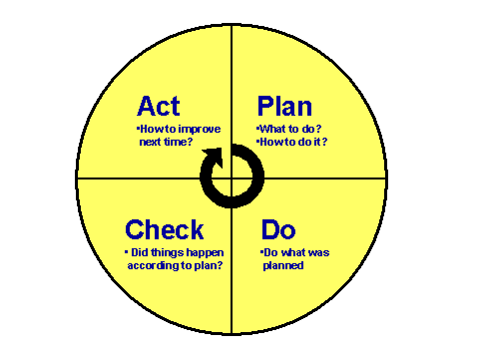
Deming Cycle

Slide 8
Identify the Customer
Value added is always determined from the customer’s perspective.
Who is the customer?
Every process should be focused on adding value to the customer.
Anything that does not add value is waste.
Some non-valued added activity is necessary waste (“NVA-R”)
  Regulatory
  Legal

Slide 9
Types of Waste
Overproduction
Excess inventory
Defects
Non-value added processing
Waiting
Underutilized people
Excess motion
Transportation

Slide 10
Identify the Current State
Crucial first step in process improvement
Deep understanding of the existing processes and dependencies
Identify all the activities currently involved in developing a new product
Observe the process first hand
Identify Value Added (VA), Non-Value Added Required (NVA-R), and Non-Value Added (NVA)
Generally creates more questions than answers

Slide 11
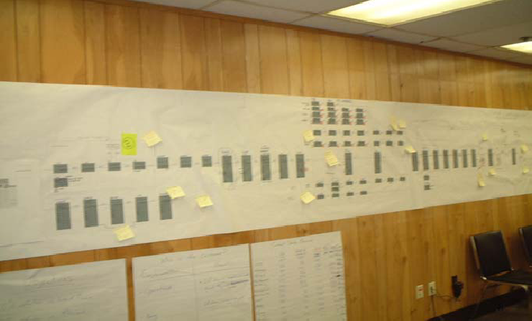
Identify the Current State

Slide 12
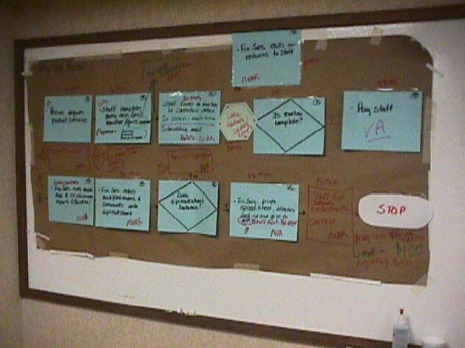
Identify VA, NVA-R, and NVA

Slide 13
Tools
Flow Charts
Cause and Effect Diagrams
Check Sheets
Histograms
Pareto Charts
Scatter Diagram
Control Charts

Slide 14
Cause and Effect Diagram (CED)
Ishikawa or Fishbone diagram
Relates causes to effects
Benefits?
Disadvantages?
How?
  Start with effect and work back to possible causes

Slide 15
Brainstorm and Analyze
Kaizen team brainstorming to develop new process
Post improvement ideas on map or by category
  Workflow
  Technology
  People / Organization
  Procedures
Develop detailed future state map
  New workflow
  Value Add and Non-Value Add
  Cycle times
  Identify Kaizen “bursts” (immediate radical change)

Slide 16
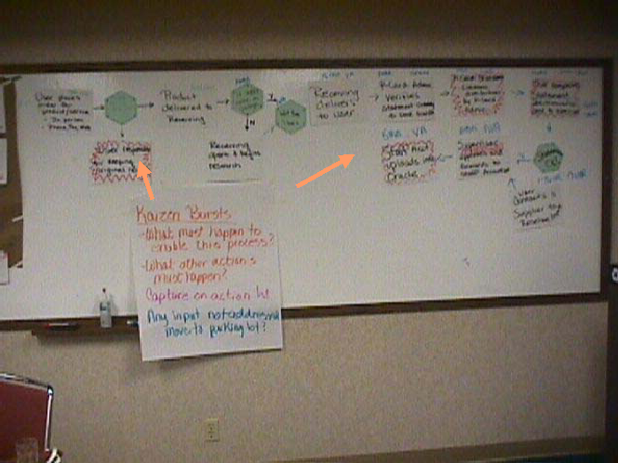
Develop the Future State

Slide 17
Implementation Plan
Think global / systems optimization
Maximum impact to process
Speed of implementation – create small victories
Cost-benefit analysis

Slide 18
Implementation Plan
Will new skill sets be required, and how to achieve them?
Is the current organization structure sufficient?
Are there cultural issues?
Is there potential for “push back”?
Any implications for suppliers?
Implications for customers?
Implications for team members?
Do current technologies support the new process? Are they available and cost justifiable?
Technology is an enabler, not a solution.
Does the reward system support the new process?

Slide 19
Execute
Develop a concise, achievable milestone plan
Communicate the plan to everyone
  Suppliers
  Team members
  Customers
Track activities in public
Celebrate small victories and publicly analyze failures

Slide 20
Check and Sustain
Meet regularly (weekly?) to review status of open implementation items
Re-evaluate Future State regularly (quarterly?) for additional improvement
Track results on a public Kaizen Board

Slide 21
Typical Results
40 – 60% reduction of lean time
10 – 15% productivity improvement
10 – 20% reduction in rework
Improved communication between functions and departments
Clearly defined customer needs throughout the value stream
Improved customer satisfaction

Slide 22
Kaizen Blitz
Total focus on a defined process to create radical improvement in a short period of time
Dramatic improvements in productivity, quality, delivery, lead-time, set-up time, space utilization, work in process, workplace organization
Typically five days (one week) long

Slide 23
Kaizen Blitz - Agenda
Day 1: Setting the scene
  Meet the team, training
Day 2: Observe the current process
  Flowchart, identify waste, identify root causes
Day 3: Develop the future state process
  Brainstorm and flowchart (typically the longest day!)
Day 4: Implement the new process
  Plan, communicate, implement, modify
Day 5: Report and analyze
  Performance vs expectations

Slide 24
Kaizen Blitz Rules
Be open to change
Stay positive
Speak out if you disagree
See waste as an opportunity
No blame environment
Treat others as you want to be treated
Ask the silly questions, challenge the givens
Creativity before capital
Understand the data and principles
Just do it!

Slide 25
Roadblocks
Too busy to study it
A good idea but the timing is premature
Not in the budget
Theory is different from practice
Isn’t there something else for you to do?
Doesn’t match corporate policy
Not our business – let someone else analyze it
It’s not improvement – it’s common sense
I know the result even if we don’t do it
Fear of accountability
Isn’t there an even better way?

